Slide 2
Topic 4 – In-Memory Data Grids, Spark
ITECH2302 Big Data Management

Slide 3
Main topics in this week
In-memory data grids
In-memory databases
3

Slide 4
In-memory storage devices -- implementation
In-memory storage devices can be implemented as
In-memory data grid(IMDG)
In-memory database(IMDB)
Notes:
Although both of these technologies use memory as their underlying data storage medium, what makes them distinct is the way data is stored in the memory. Key features of each of these technologies are discussed next.
4

Slide 5
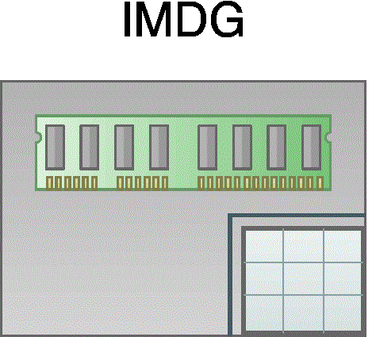
In-memory data grids(IMDGs)
The symbol used to represent an IMDG.
IMDGs store data in memory as key-value pairs across multiple nodes
the keys and values can be any business object or application data in serialized form.
This supports schema-less data storage through storage of semi/unstructured data.
Data access is typically provided via APIs
Notes:
IMDGs store data in memory as key-value pairs across multiple nodes where the keys and values can be any business object or application data in serialized form. This supports schema-less data storage through storage of semi/unstructured data. Data access is typically provided via APIs the symbol used to depict an IMDG is shown in figure
5

Slide 6
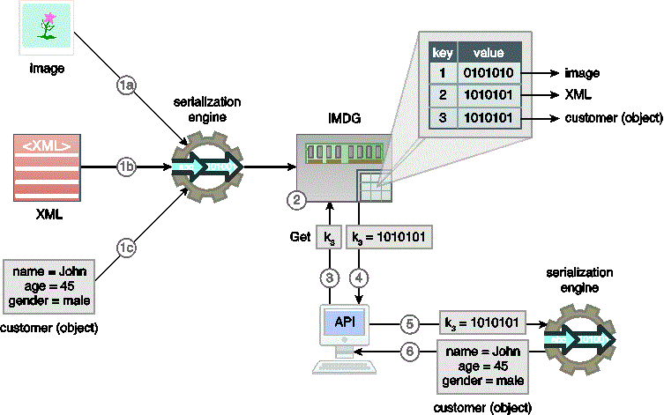
In-memory data grids(IMDGs)
An IMDG storage device.
Notes:
In figure
1 an image (a), XML data (b) and a customer object (c) are first serialized using a serialization engine
2 They are then stored as key-value pairs in an IMDG
3. A client requests the customer object via its key
4. the value is then returned by the IMDG in serialized form
5 the client then utilizes a serialization engine to deserialize the value to obtain the customer object
6.. in order to manipulate the customer object
Nodes in IMDGs keep themselves synchronized and collectively provide high availability, fault tolerance and consistency. In comparison to NoSQL’s eventual consistency approach, IMDGs support immediate consistency.
6

Slide 7
In-memory data grids(IMDGs)
Features of IMDG
IMDGs provide faster data access because
IMDGs store non-relational data as objects
object-to-relational mapping is not required and clients can work directly with the domain specific objects
IMDGs scale horizontally by implementing data partitioning and data replication
Notes:
As compared to relational IMDBs(discussed under IMDB), IMDGs provide faster data access as IMDGs store non-relational data as objects. Hence, unlike relational IMDBs, object-to-relational mapping is not required and clients can work directly with the domain specific objects
IMDGs scale horizontally by implementing data partitioning and data replication and further support reliability by replicating data to at least one extra node. In case of a machine failure, IMDGs automatically re-create lost copies of data from replicas as part of the recovery process.
7

Slide 8
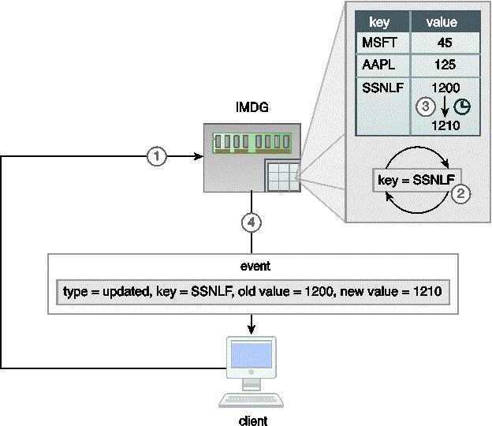
In-memory data grids(IMDGs)
An IMDG stores stock prices where the key is the stock symbol, and the value is the stock price (shown as text for readability). A client issues a continuous query (key=SSNLF) (1) which is registered in the IMDG (2). When the stock price for SSNLF stock changes (3), an updated event is sent to the subscribing client that contains various details about the event (4).
IMDGs are heavily used for realtime analytics
This is achieved through a feature called continuous querying, also known as active querying,
Notes:
IMDGs are heavily used for realtime analytics because they support complex Event Processing(CEP) via the publish-subscribe messaging model. This is achieved through a feature called continuous querying, also known as active querying, where a filter for event(s) of interest is registered with the IMDG. The IMDG then continuously evaluates the filter and whenever the filter is satisfied as a result of insert/update/delete operations, subscribing clients are informed(figure ). Notifications are sent asynchronously as change events. Such as added, removed and updated events, with information about -key-value pairs, such as old and new values.
8

Slide 9
In-memory data grids(IMDGs)
Functionality of IMDG
IMDG provides memory-based access to frequently accessed data.
However, unlike a distributed cache, an IMDG provides built in support for replication and high availability.
Realtime processing engines can make use of IMDG where high velocity data is stored in the IMDG
This makes data processing orders of magnitude faster
IMDGs may also support in-memory MapReduce that helps to reduce the latency of disk-based MapReduce processing
Notes:
From a functionality point of view, and IMDG is akin to a distributed cache as both provide memory-based access to frequently accessed data. However, unlike a distributed cache, an IMDG provides built in support for replication and high availability.
Realtime processing engines can make use of IMDG where high velocity data is stored in the IMDG as it arrives and is processed there before being saved to an on-disk storage device, or data from the on-disk storage device is copied to the IMDG. This makes data processing orders of magnitude faster and further enables data-reuse in case multiple jobs or iterative algorithms are un against the same data. IMDGs may also support in-memory MapReduce that helps to reduce the latency of disk based MapReduce processing, especially when the same job needs to be executed multiple times.
9

Slide 10
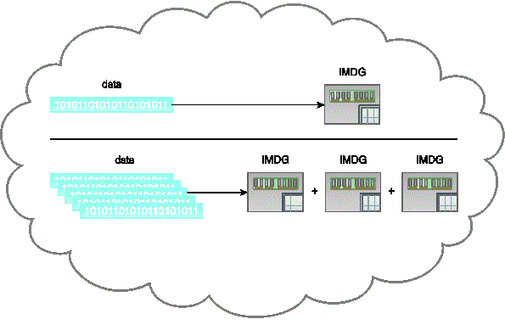
In-memory data grids(IMDGs)
An IMDG deployed in a cloud scales out automatically as the demand for data storage increases.
An IMDG can also be deployed within a cloud-based environment
IMDGs can be added to existing big data solutions by introducing them between the existing on-disk storage device and the data processing application.
Notes:
An IMDG can also be deployed within a cloud based environment where it provides a flexible storage medium that can scale out or scale in automatically as the storage demand increases or decreases, as shown in figure
IMDGs can be added to existing big data solutions by introducing them between the existing on-disk storage device and the data processing application. However, this introduction generally requires changing the application code to implement the IMDGs API.
10

Slide 11
In-memory data grids(IMDGs)
IMDGs are often deployed together with on-disk storage devices that act as the backend storage.
This is achieved via the following approaches
Read-through
Write-through
Write-behind
Refresh-ahead
Notes:
In a big data solution environment, IMDGs are often deployed together with on-disk storage devices that act as the backend storage. This is achieved via the following approaches that can be combined as necessary to support read/write performance, consistency and simplicity requirements:
Read-through
Write-through
Write-behind
Refresh-ahead
Read-through
11

Slide 12
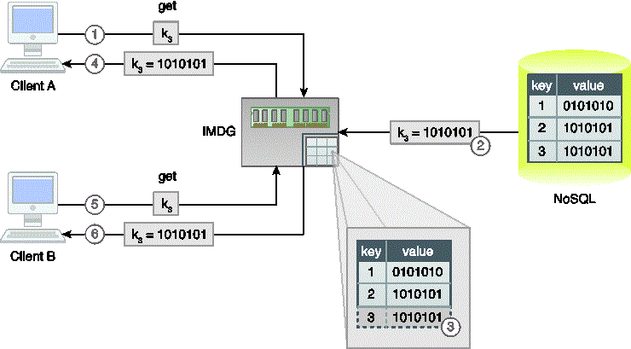
In-memory data grids(IMDGs)
An example of using an IMDG with the read-through approach.
Read-through
If a requested value for a key is not found in the IMDG, then it is synchronously read from the backend on-disk storage device, such as a database.
Upon a successful read from the backend on-disk storage device, the key-value pair is inserted into the IMDG, and the requested value is returned to the client.
Notes:
If a requested value for a key is not found in the IMDG, then it is synchronously read from the backend on-disk storage device, such as a database. Upon a successful read from the backend on-disk storage device, the key-value pair is inserted into the IMDG, and the requested value is returned to the client. Any subsequent requests for the same key are then served by the IMDG directly, instead of the backend storage. Although it is a simple approach, its synchronous nature may introduce read latency. Figure is an example of the read-through approach, where Client A tries to read key K3(1) which does not currently exist in the IMDG. Consequently, it is read from the backend storage (2) and inserted into the IMDG (3) before being sent to Client A (4). A subsequent request for the same key by Client B(5) is then served directly by the IMDG (6).
12

Slide 13
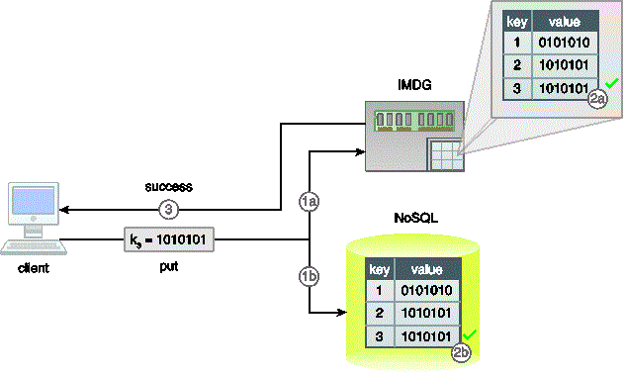
In-memory data grids(IMDGs)
Write-through
Any write (insert/update/delete) to the IMDG is written synchronously to the backend on-disk storage device, such as a database.
If the write to the backend on-disk storage device fails, the IMDG’s update is rolled back.
Data consistency is achieved immediately between the two data stores.
A client inserts a new key-value pair (K3,V3) which is inserted into both the IMDG (1a) and the backend storage (1b) in a transactional manner. Upon successful insertion of data into the IMDG (2a) and the backend storage (2b), the client is informed that data has been successfully inserted (3).
Notes:
Any write (insert/update/delete) to the IMDG is written synchronously in a transactional manner to the backend on-disk storage device, such as a database. If the write to the backend on-disk storage device fails, the IMDG’s update is rolled back. Due to this transactional nature, data consistency is achieved immediately between the two data stores. However, this transactional support is provided at the expense of write latency as any write operation is considered complete only when feedback (write success/failure) from the backend storage is received(figure ).
13

Slide 14
In-memory data grids(IMDGs)
Write-behind
Any write to the IMDG is written asynchronously in a batch manner to the backend on-disk storage device, such as a database.
A queue is generally placed between the IMDG and the backend storage for keeping track of the required changes to the backend storage.
The asynchronous nature increases both
write performance( the write operation is considered completed as soon as it is written to the IMDG) and
read performance(data can be read from the IMDG as soon as it is written to the IMDG) and scalability/availability in general
Notes:
Any write to the IMDG is written asynchronously in a batch manner to the backend on-disk storage device, such as a database.
A queue is generally placed between the IMDG and the backend storage for keeping track of the required changes to the backend storage. This queue can be configured to write data to the backend storage at different intervals.
The asynchronous nature increases both write performance( the write operation is considered completed as soon as it is written to the IMDG) and read performance(data can be read from the IMDG as soon as it is written to the IMDG) and scalability/availability in general
14

Slide 15
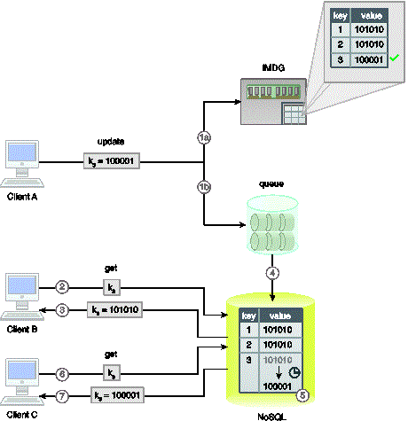
In-memory data grids(IMDGs)
An example of the write-behind approach.
Write-behind
Notes:
However, the asynchronous nature introduces inconsistency until the backend storage is updated at the specified interval.
In Figure :
1 client A updates value of K3, which is updated in the IMDG (a) and is also sent to a queue (b)
2. However, before the backend storage is updated, Client B makes a request for the same key.
3. the old value is sent
4. after the configured interval
5. the backend storage is eventually updated
6. Client C makes a request of the same key
7. this time, the updated value is sent
15

Slide 16
In-memory data grids(IMDGs)
Refresh-ahead
Refresh-ahead is a proactive approach
where any frequently accessed values are automatically, asynchronously refreshed in the IMDG,
If a value is accessed after its expiry time, the value, like in the read-through approach, is synchronously read from the backend storage and updated in the IMDG before being returned to the client.
Notes:
Refresh-ahead is a proactive approach where any frequently accessed values are automatically, asynchronously refreshed in the IMDG, provided that the value is accessed before its expiry time as configured in the IMDG. If a value is accessed after its expiry time, the value, like in the read-through approach, is synchronously read from the backend storage and updated in the IMDG before being returned to the client.
16

Slide 17
In-memory data grids(IMDGs)
Refresh-ahead
This approach helps achieve better read-performance and is especially useful
when the same values are accessed frequently or accessed by a number of clients.
Data inconsistency between the IMDG and the backend storage is minimized
as values are refreshed before they expire.
Notes:
Due to its asynchronous and forward-looking nature, this approach helps achieve better read-performance and is especially useful when the same values are accessed frequently or accessed by a number of clients.
Compared to the read-through approach, where a value is served from the IMDG until its expiry, data inconsistency between the IMDG and the backend storage is minimized as values are refreshed before they expire.
17

Slide 18
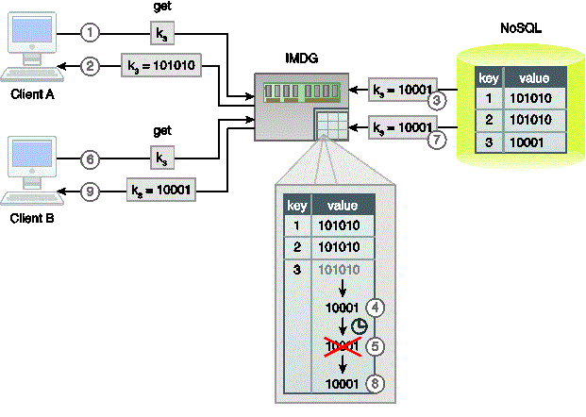
In-memory data grids(IMDGs)
An example of an IMDG leveraging the refresh-ahead approach.
Notes:
In figure :
1 Client A requests K3 before its expiry time
2. The current value is returned from the IMDG
3. The value is refreshed from the backend storage
4. The value is then updated in the IMDG asynchronously
5. After the configured expiry time, the key-value pair is evicted from the IMDG
6. Now client B makes a request for K3
7. As the key does not exist in the IMDG, it is synchronously requested from the backend storage
8. and updated
9. The value is then returned to Client B
18

Slide 19
Summary of In-memory data grids
An IMDG storage device is appropriate when:
Data needs to be readily accessible in object form with minimal latency
Data being stored is non-relational in nature such as semi-structured and unstructured data
Adding realtime support to an existing big data solution currently using on-disk storage
The existing storage device cannot be replaced but the data access layer can be modified
Scalability is more important than relational storage;
Examples of IMDG storage devices include: Hazelcast, Infinispan, Pivotal GemFire, etc.
Notes:
An IMDG storage device is appropriate when:
Data needs to be readily accessible in object form with minimal latency
Data being stored is non-relational in nature such as semi-structured and unstructured data
Adding realtime support to an existing big data solution currently using on-disk storage
The existing storage device cannot be replaced but the data access layer can be modified
Scalability is more important than relational storage; although IMDGs are more scalable than IMDBs(IMDBs are functionally complete databases), they do not support relational storage.
Examples of IMDG storage devices include: Hazelcast, Infinispan, Pivotal GemFire, etc.
19

Slide 20
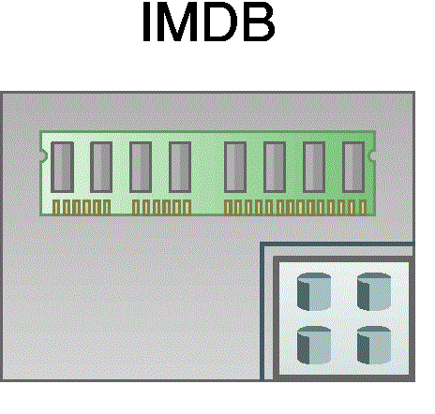
In-memory databases(IMDBs)
Representation of an IMDB.
IMDBs are in-memory storage devices
IMDBs
employ database technology and
leverage the performance of RAM to overcome runtime latency issues that plague on-disk storage devices.
Notes:
20

Slide 21
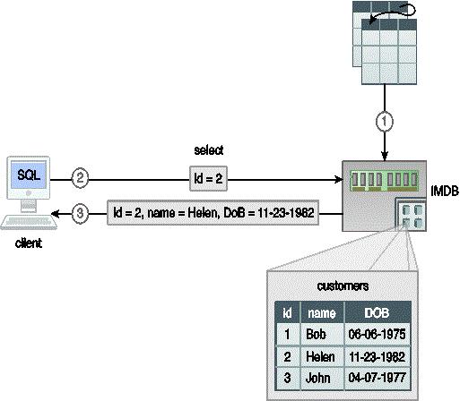
In-memory databases(IMDBs)
An example depicting the retrieval of data from an IMDB.
Notes:
In figure
1 A relational dataset is stored into an IMDB
2. A client requests a customer record (id =2) via SQL
3. the relevant customer record is then returned by the IMDB, which is directly manipulated by the client without the need for any deserialization.
21

Slide 22
In-memory databases(IMDBs)
An IMDB can be relational in nature(relational IMDB) for the storage of structured data, or
may leverage NoSQL technology(non-relational IMDB) for the storage of semi-structured and unstructured data.
Relational IMDBs make use of the more familiar SQL language,
which helps data analysts or data scientists that do not have advanced programming skills.
NoSQL-based IMDBs generally provide API-based access,
which may be as simple as put, get and delete operations.
Notes:
An IMDB can be relational in nature(relational IMDB) for the storage of structured data, or may leverage NoSQL technology(non-relational IMDB) for the storage of semi-structured and unstructured data.
Unlike IMDGs, which generally provide data access via APIs, relational IMDBs make use of the more familiar SQL language, which helps data analysts or data scientists that do not have advanced programming skills. NoSQL-based IMDBs generally provide API-based access, which may be as simple as put, get and delete operations. Depending on the underlying implementation, some IMDBs scale-out, while others scale-up, to achieve scalability.
22

Slide 23
In-memory databases(IMDBs)
An IMDB leverages various strategies for providing durability in the face of machine failures or memory corruption. These strategies include the following:
Use of Non-volatile RAM(NVRRAM) for storing data permanently
Database transaction logs can be periodically stored to a non-volatile medium, such as disk.
Snapshot files, which capture database state at a certain point in time, are saved to disk.
An IMDB may leverage sharding and replication to support increasing availability and reliability as a substitute for durability.
IMDBs can be used in conjunction with on-disk storage devices such as NoSQL databases and RDBMSs for durable storage.
Notes:
Not all IMDB implementations directly support durability, but instead leverage various strategies for providing durability in the face of machine failures or memory corruption. These strategies include the following:
Use of Non-volatile RAM(NVRRAM) for storing data permanently
Database transaction logs can be periodically stored to a non-volatile medium, such as disk.
Snapshot files, which capture database state at a certain point in time, are saved to disk.
An IMDB may leverage sharding and replication to support increasing availability and reliability as a substitute for durability.
IMDBs can be used in conjunction with on-disk storage devices such as NoSQL databases and RDBMSs for durable storage.
23

Slide 24
In-memory databases(IMDBs)
An IMDB may also support the continuous query feature,
where a filter in the form of a query for data of interest is registered with the IMDB.
The IMDB then continuously executes the query in an iterative manner.
Whenever the query result is modified as a result of insert/update/delete operations,
subscribing clients are asynchronously informed by sending out changes as events, such as added, removed and updated events,
Notes:
Like an IMDG, an IMDB may also support the continuous query feature, where a filter in the form of a query for data of interest is registered with the IMDB. The IMDB then continuously executes the query in an iterative manner. Whenever the query result is modified as a result of insert/update/delete operations, subscribing clients are asynchronously informed by sending out changes as events, such as added, removed and updated events, with information about record values, such as old and new values.
24

Slide 25
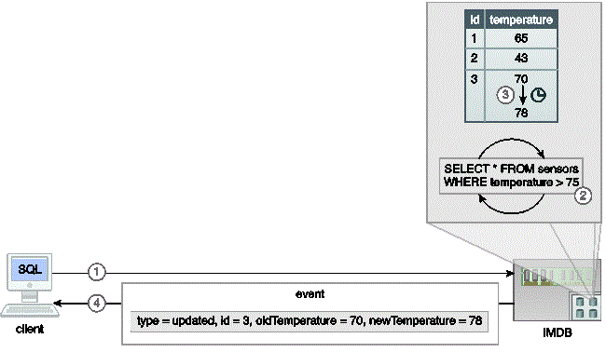
In-memory databases(IMDBs)
An example of IMDB storage configured with a continuous query.
Notes:
In figure, an IMDB stores temperature values for various sensors. The following steps are shown:
A client issues a continuous query(select * from sensors where temperature >75)
It is registered in the IMDB
When the temperature for any sensor exceeds 75F
4 An updated event is sent to the subscribing client that contains various details about the event.
25

Slide 26
In-memory databases(IMDBs)
IMDBs are heavily used in realtime analytics
IMDBs can further be used for developing low latency applications requiring full ACID transaction support( relational IMDB).
In comparison with IMDGs, IMDBs provide an easy to set up in-memory data storage options,
as IMDBs do not generally require on-disk backend storage devices.
Notes:
IMDBs are heavily used in realtime analytics and can further be used for developing low latency applications requiring full ACID transaction support( relational IMDB). In comparison with IMDGs, IMDBs provide an easy to set up in-memory data storage options, as IMDBs do not generally require on-disk backend storage devices.
26

Slide 27
Summary of IMDBs
An IMDB storage device is appropriate when
Relational data needs to be stored in memory with ACID support
Adding realtime support to an existing Big Data solution currently using on-disk storage
The existing on-disk storage device can be replaced with an in-memory equivalent technology
It is required to minimize changes to the data access layer of the application code
Relational storage is more important than scalability
Notes:
An IMDB storage device is appropriate when
Relational data needs to be stored in memory with ACID support
Adding realtime support to an existing Big Data solution currently using on-disk storage
The existing on-disk storage device can be replaced with an in-memory equivalent technology
It is required to minimize changes to the data access layer of the application code
Relational storage is more important than scalability
27

Slide 28
End of the lecture
Questions, comments
Notes:
28

